Slide 1

Impact of Provider Prescribing Patterns on Opioid Related Overdoses in the United States : A Four Year Review
Hadijat Makinde, Alex Talento, Tyler Cobb, Armi Cachila, John Rafferty, Rick Clauss, Yazan Rizeq

Slide 2
Background
The opioid epidemic has spread to almost every corner of the united states
In the midst of our national opioid crisis, recommendations have encouraged judicious stewardship of opioid prescription through the expanded use of non-opioid analgesic medications.
Trends of opioids usage have been well documented; however, these data have limited information in regard to provider practice variation.
Therefore, the primary aim of our study is to identify prescribing provider practice variation using a large national database.
The second aim of our study is to compare these data with a national overdose(OD) dataset to identify potential patterns in prescribing and overdose rates.

Slide 3
The numbers don’t lie.
https://www.hhs.gov/opioids/about-the-epidemic/index.html

Slide 4
Pass the opioid please.
A compound resembling opium in addictive properties or physiological effects.
Opioids are a class of drugs that include the illegal drug heroin, synthetic opioids such as fentanyl, and pain relievers available legally by prescription, such as oxycodone (OxyContin®), hydrocodone (Vicodin®), codeine, morphine, tramadol and many others
Opioid pain relievers are generally safe when taken for a short time and as prescribed by a doctor, but because they produce euphoria in addition to pain relief, they can be misused.
Regular use—even as prescribed by a doctor—can lead to dependence and, when misused, opioid pain relievers can lead to addiction, overdose incidents, and deaths.

Slide 5
Questions and Hypothesis
What are the opioid prescribing patterns in the United States?
What demographic is affected by the opioid epidemic
Age
Gender
Ethnicity
What drug types are responsible
Hypothesize that as the increase in prescription rates will correlate with increase in overdose rates

Slide 6
Methods
Study Design :
A cross-sectional, retrospective review will be conducted using the Centers for Medicare & Medicaid Services (CMS) and data from the Kaiser Family Foundation (KFF).
CMS data presents information on the individual opioid prescribing rates of health providers that participate 2013-2016. These data is a prescriber-level data set that provides data on the number and percentage of prescription claims (includes new prescriptions and refills) for opioid drugs, and contains information on each provider’s name, specialty, state, and ZIP code.
KFF data hold information on all overdoses from year 2013-2016. Including stratification by gender ethnicity, drug type and age
All data were mined as .csv files, the files were analyzed using python pandas and matplotlip.

Slide 7
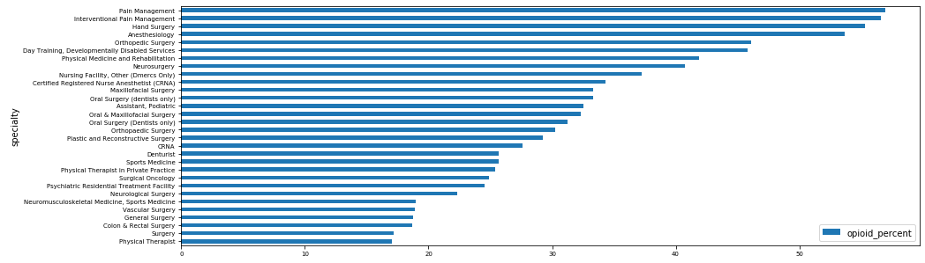
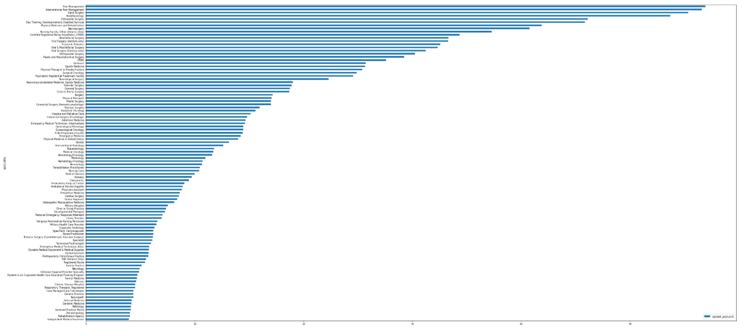
Opioid Claims (Prescriptions) Pattern By Practice Specialty
50% of the top 30 prescribing specialty are surgery related

Slide 8
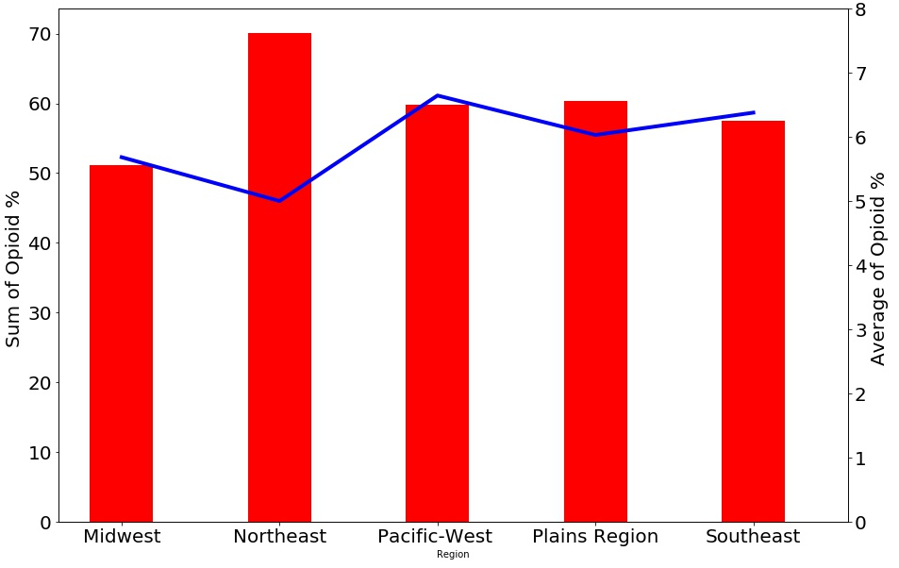
Rate of opioid prescriptions per region

Slide 9
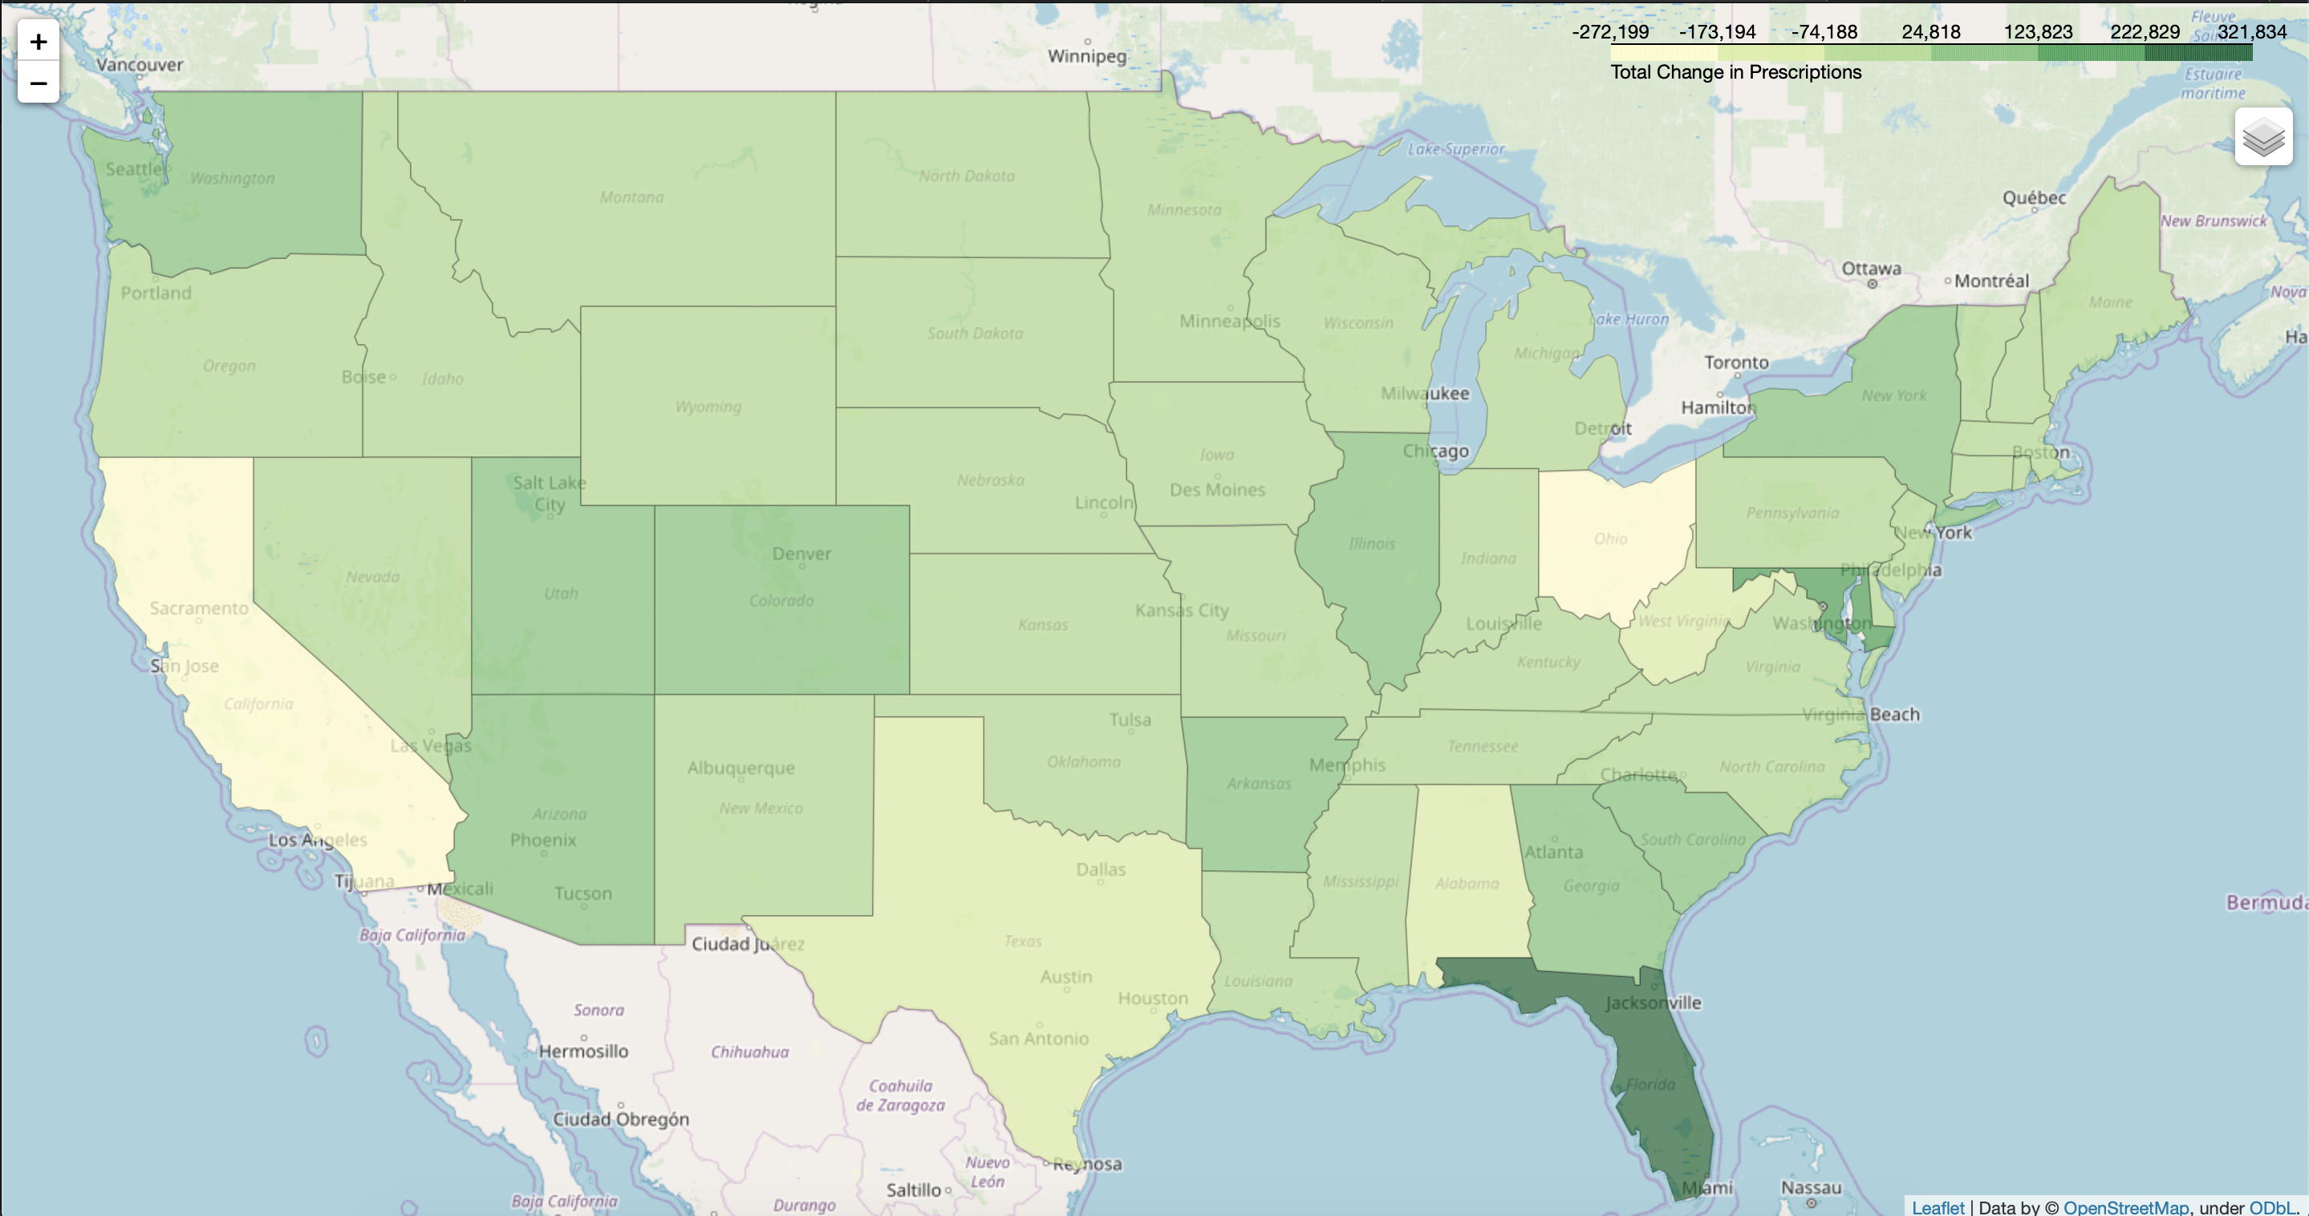
Total Change in Opioid Prescriptions 2013-1016

Slide 10
Summary of opioid prescriptions rates
50% of the top 30 prescribing specialty are surgery related
The northeast region had the highest total rate of prescription
but the lowest rate of prescription per state
The biggest changes in rate of prescription were observed in the eastern region of the country

Slide 11
What is the demographic breakdown of OD in the US

Slide 12
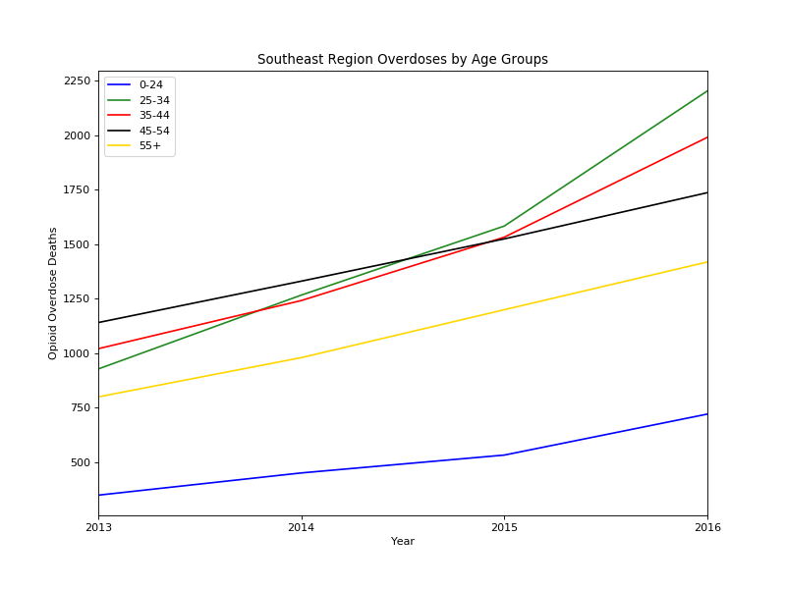
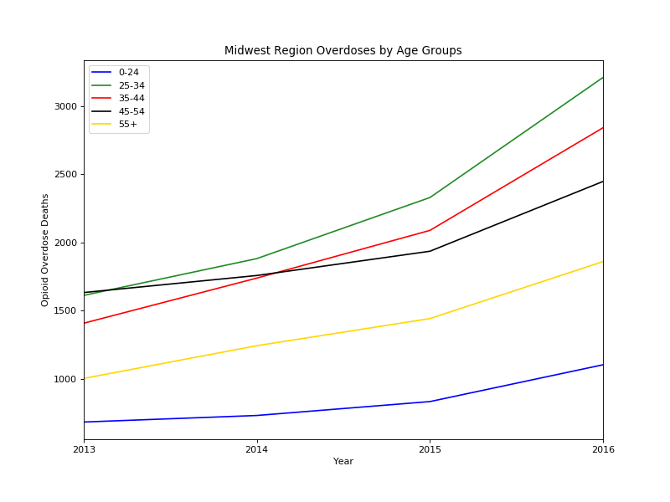
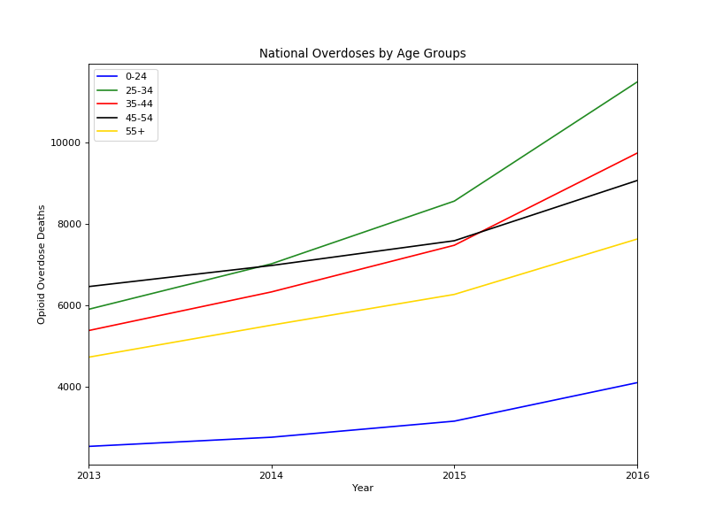
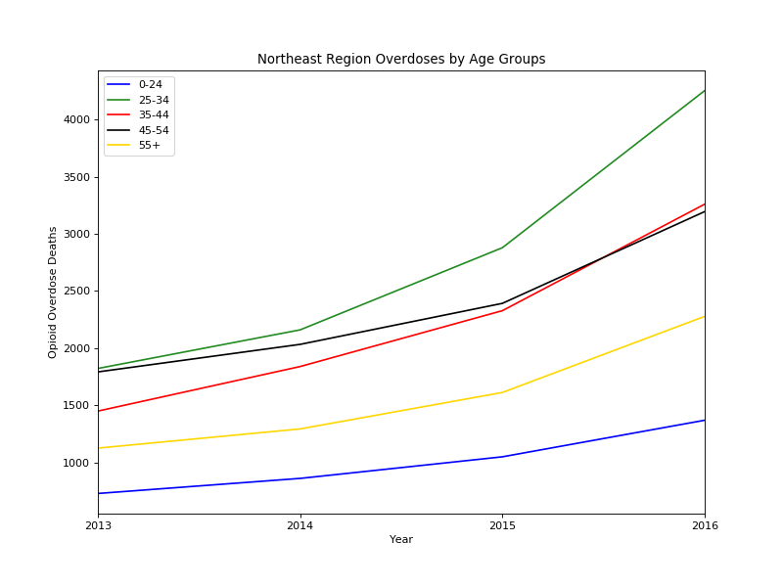
Opioid deaths by age range
Midwest
National
Number of Deaths
Northeast
Years

Slide 13
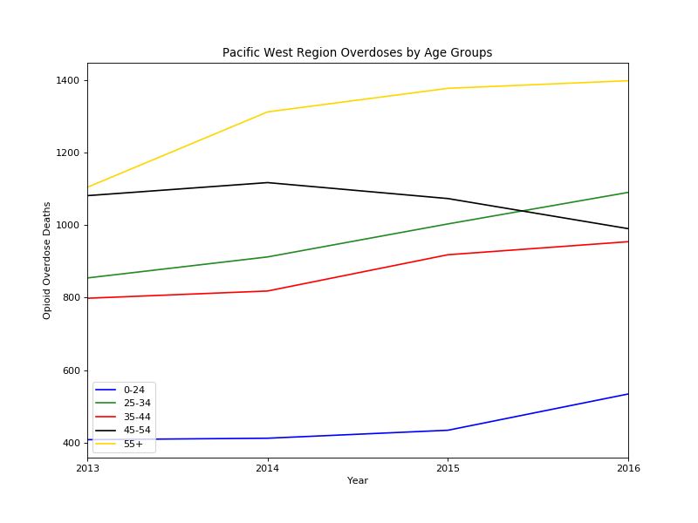
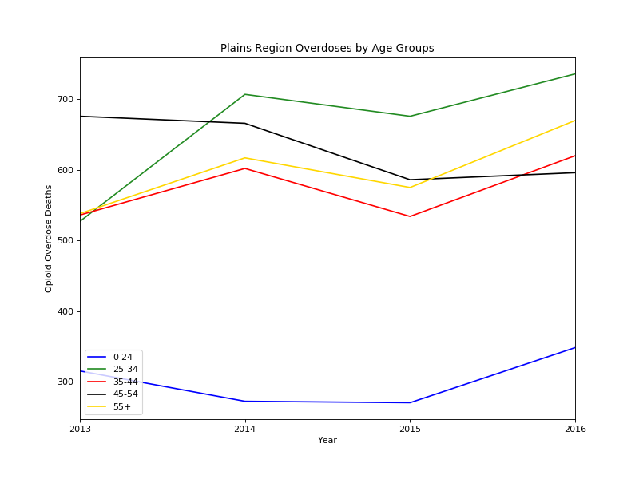
Opioid deaths by age range
Southwest
Pacific West
Plains

Slide 14
Opioid deaths by age range
For the overall national trends and most regions the greatest mortality is in the 25-34 age group, followed by tie between 35-44 and 45-54.
0-24 group is consistently lowest in all regions.
Midwest, Northeast, and Southeast regions closely follow national trends
Pacific West and Plains regions have smallest total deaths and more states without data, showing deviation from national trends.
General year-over-year increase for all age groups.

Slide 15
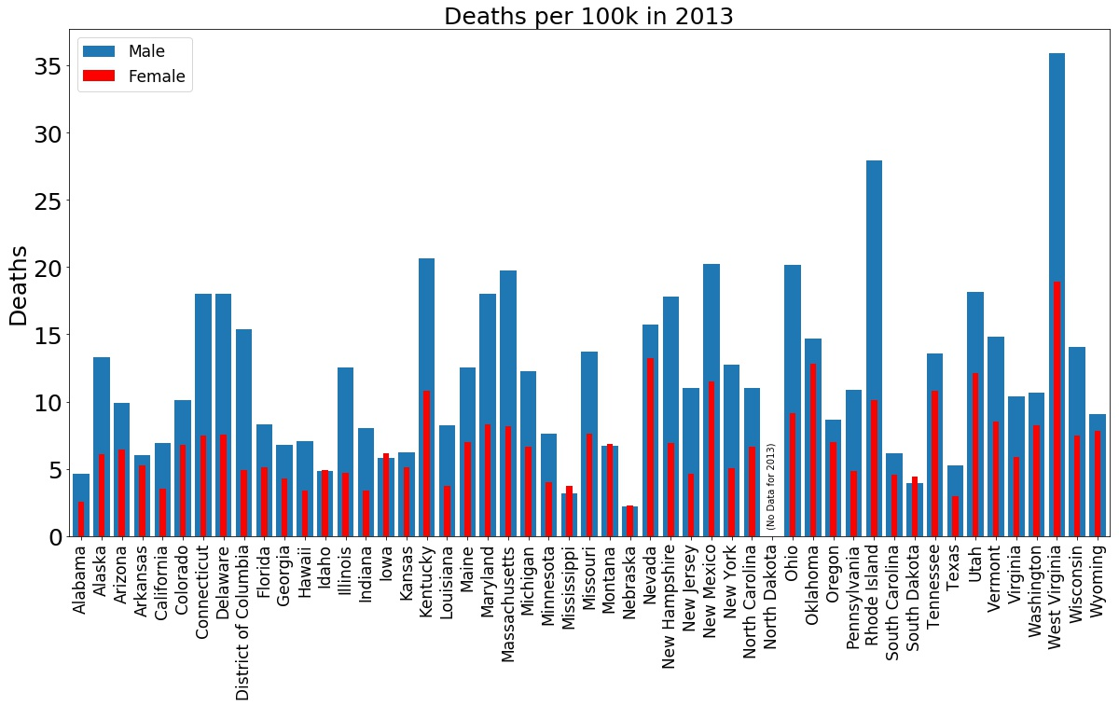
How does the opioid related death vary by gender?

Slide 16
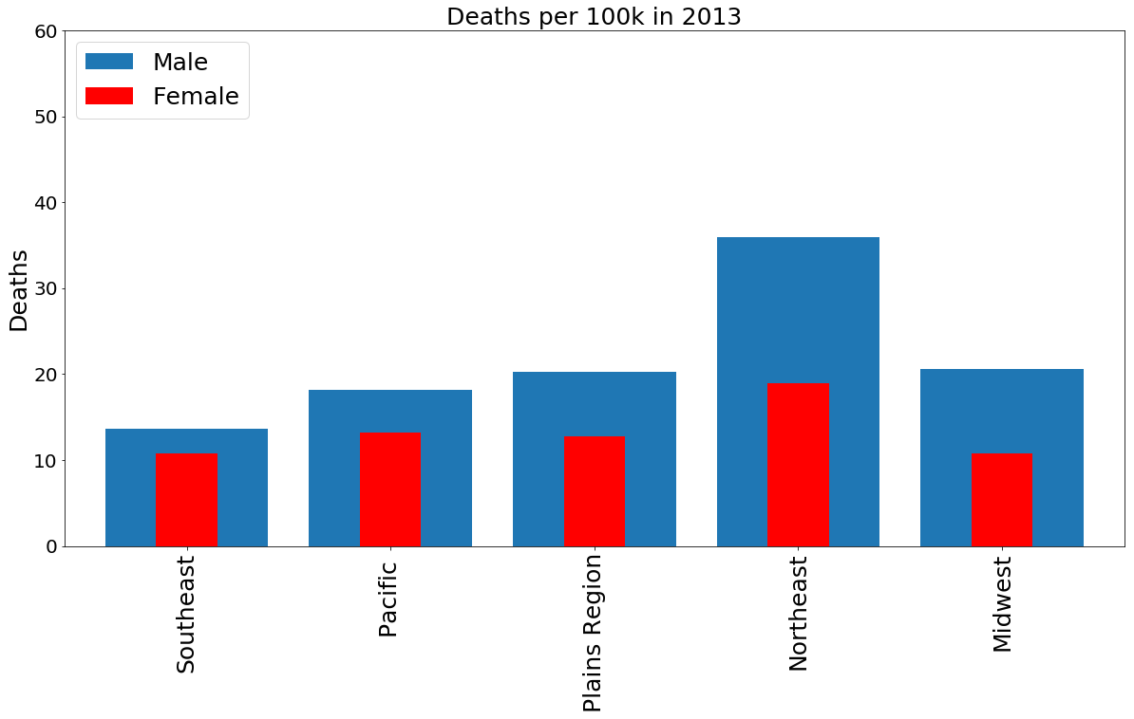
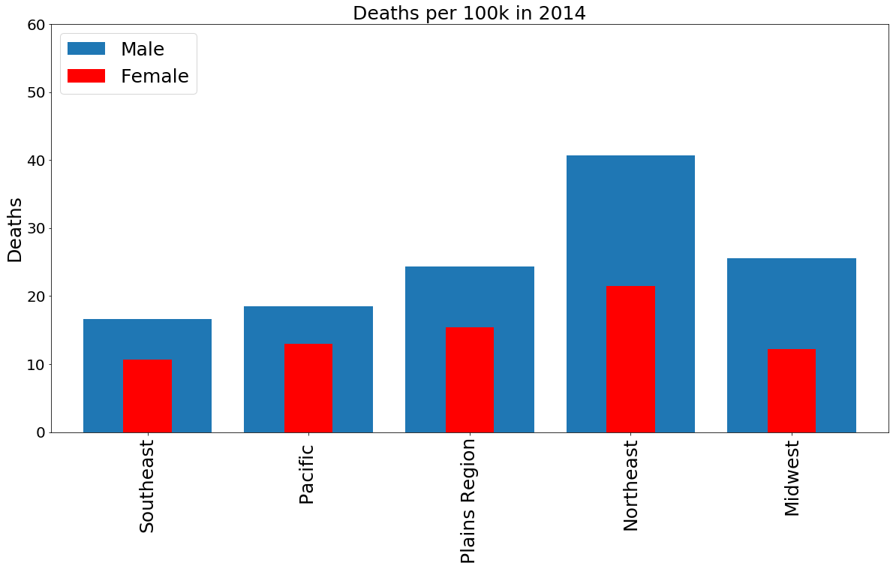
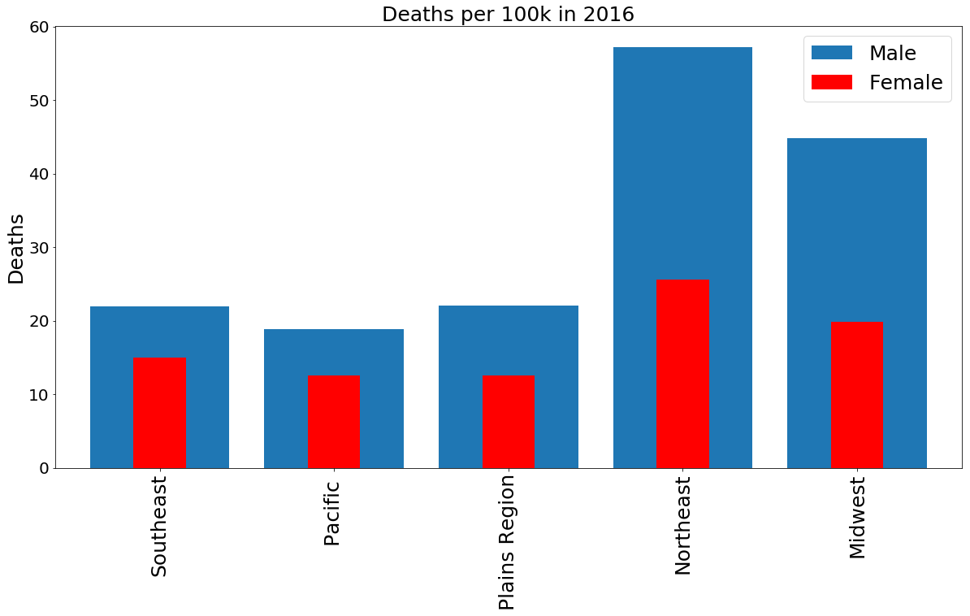
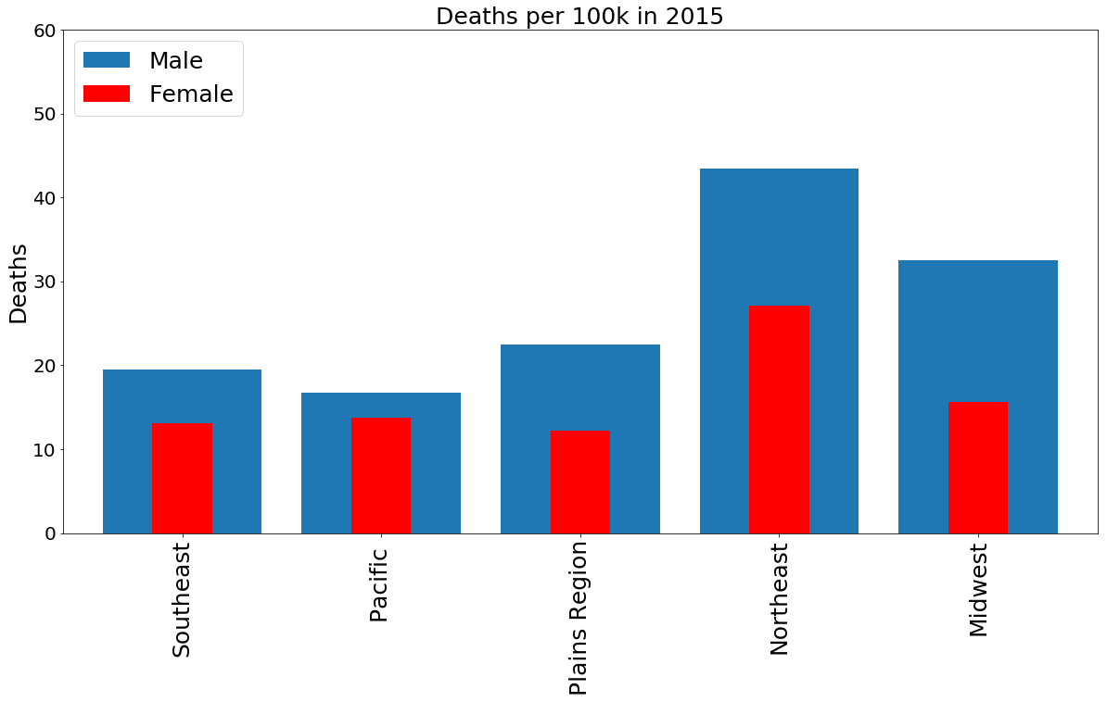
Opioid related death by gender per region
2013
2014
2013
2016
2015

Slide 17
Opioid Deaths by Gender
Across all regions men are more likely than women to die form an opioid overdose.
However, when seen at the state level there are several years where states in the Plains region see women dying at a higher rate per capita.
Between 2014 and 2015 there was a drop in opioid overdoses in the Pacific and Plains regions except for the women of pacific region who saw a slight increase while male overdoses saw a slight decrease.
While the women of the pacific region saw an increase from 2014 to 2015 they’ve actually seen a decrease from 2013-2016
By about a 0.5% but still impressive compared to every other group in this study.

Slide 18
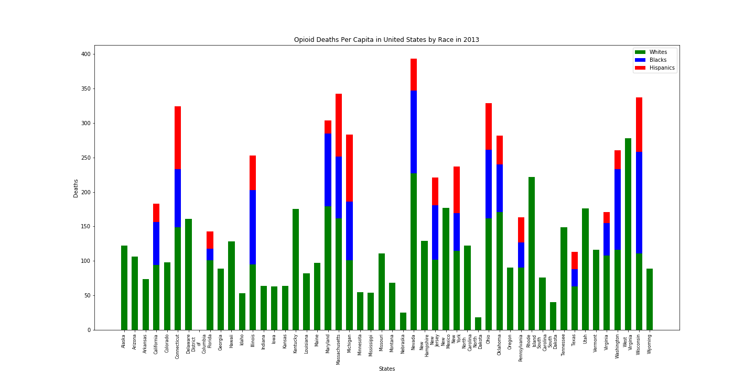
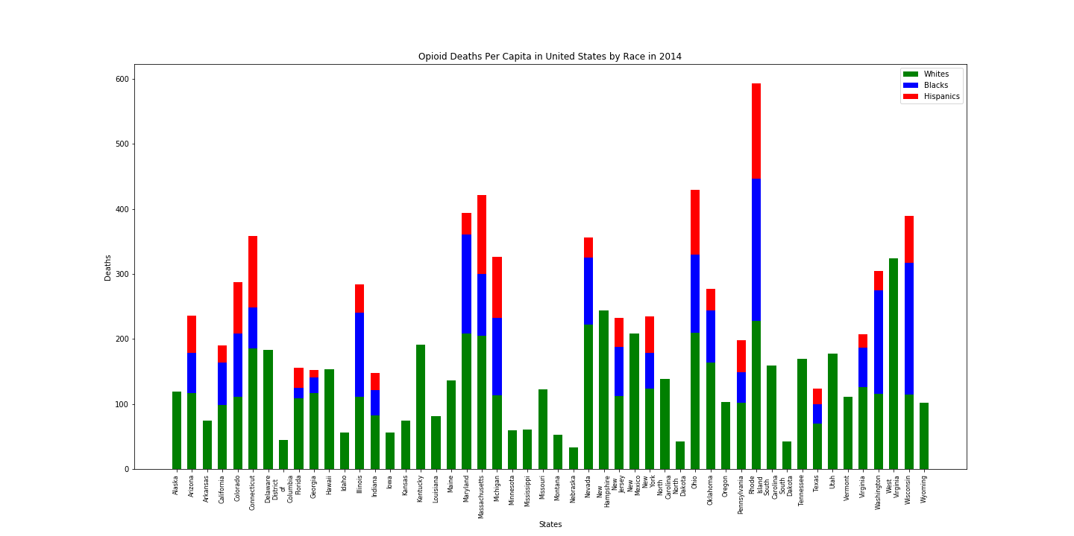
How does the opioid related death vary by ethnicity?
2013
2014

Slide 19
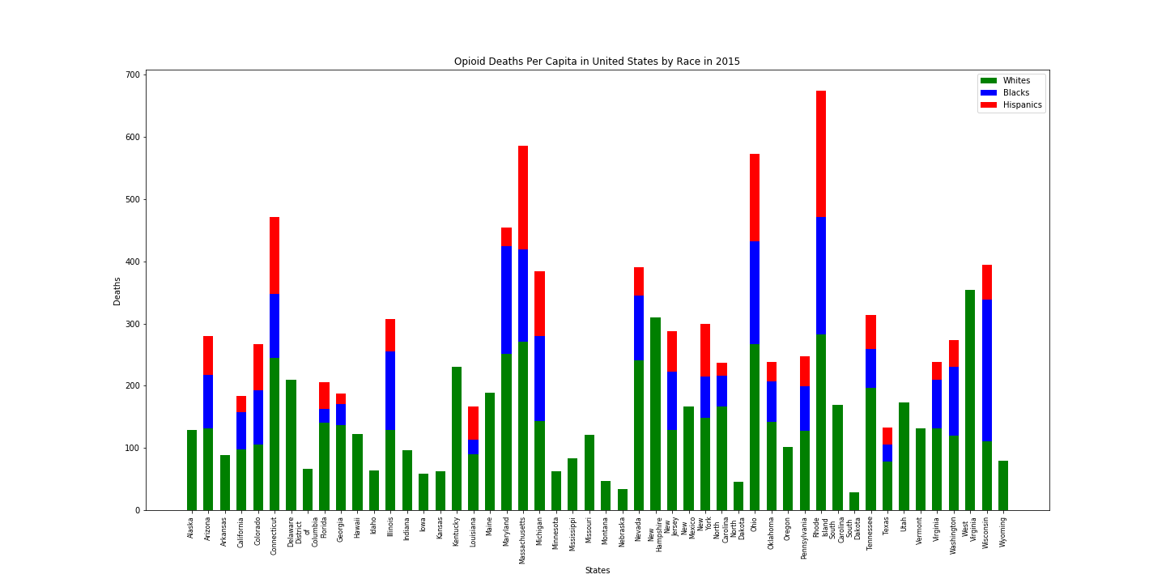
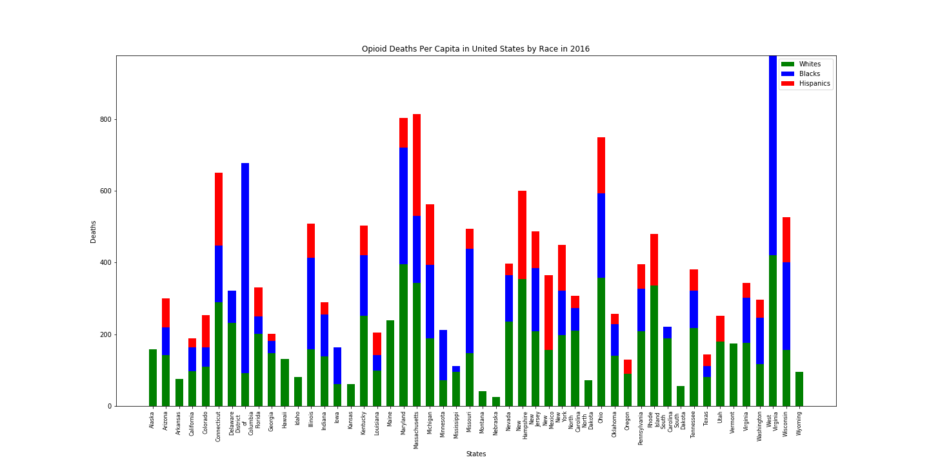
2015
2016

Slide 20
Opioid Deaths by Ethnicity
The vast majority of those who overdose on opioids are white Americans, who make up close to 80% of the annual total number of overdoses.
-Black Americans account for 11%, while Hispanic Americans make up 8% of Opioid overdose deaths.
West Virginia has the highest per capita overdose rate for Americans overall
White Americans at 324 people per 1 million.
In 2016, African Americans had a rate of 564 OD per 1 million people in West Virginia (known as the “epicenter of the opioid crisis)
In Massachusetts, the opioid OD rate for Latinos has more than tripled from the years 2013 to 2016. (91 in 2013 to 285 (per million) in 2016)

Slide 21
Total Change in Opioid Prescriptions 2013-1016

Slide 22
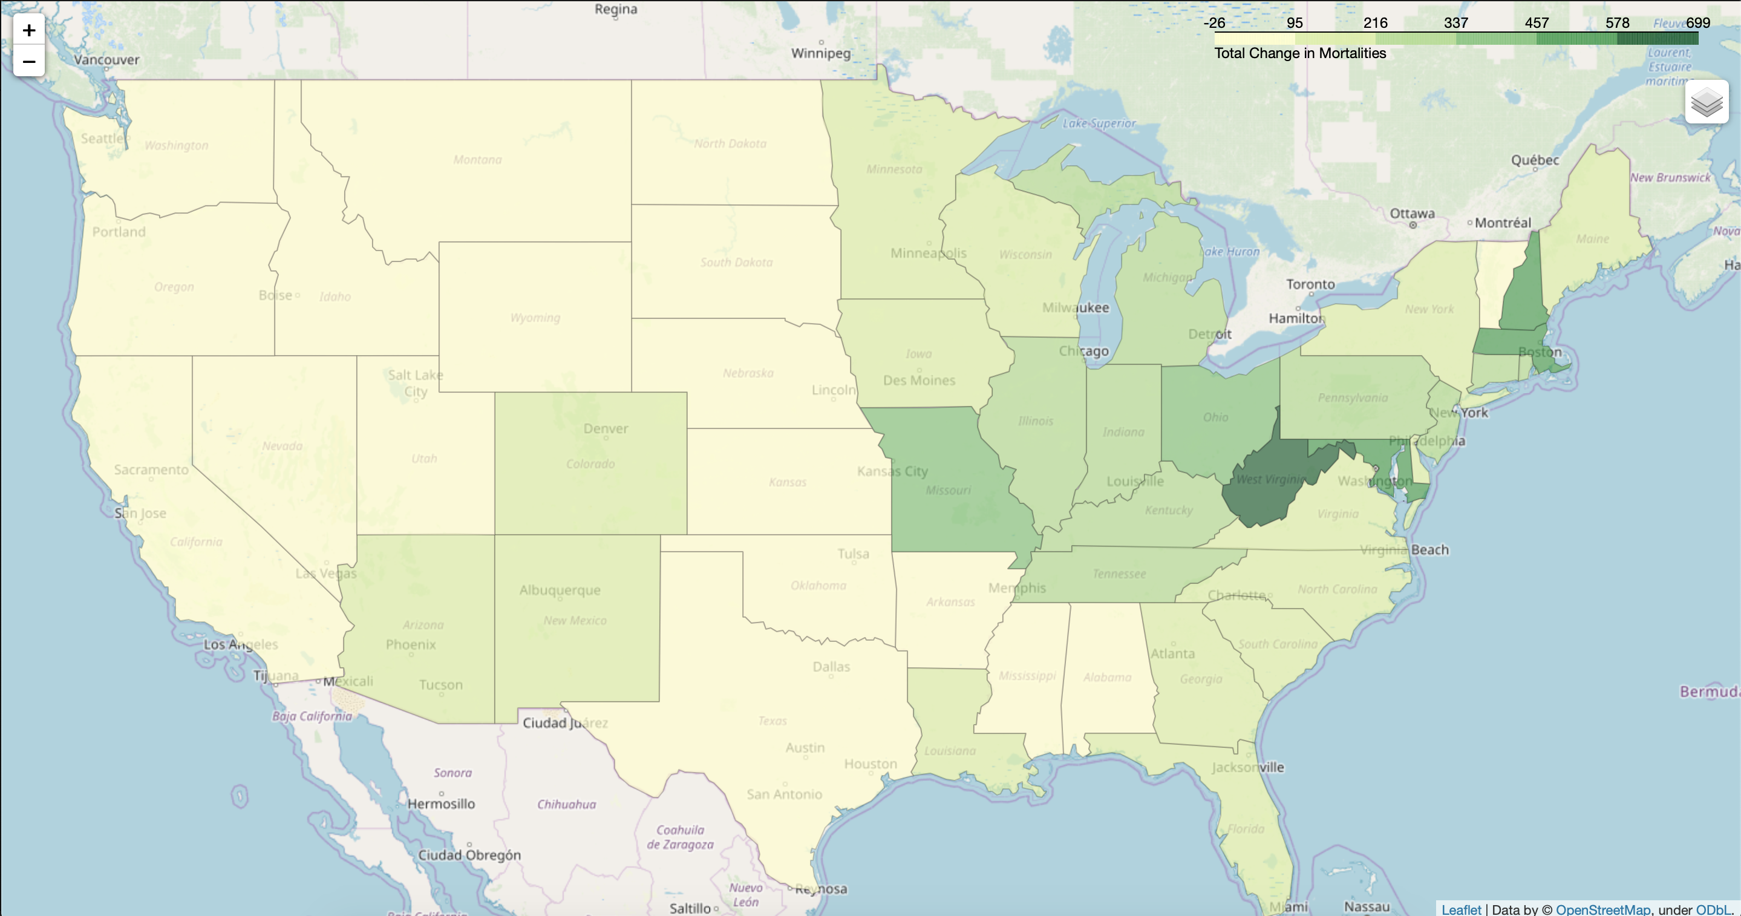
Total Change in Opioid Mortalities. 2013-2016

Slide 23
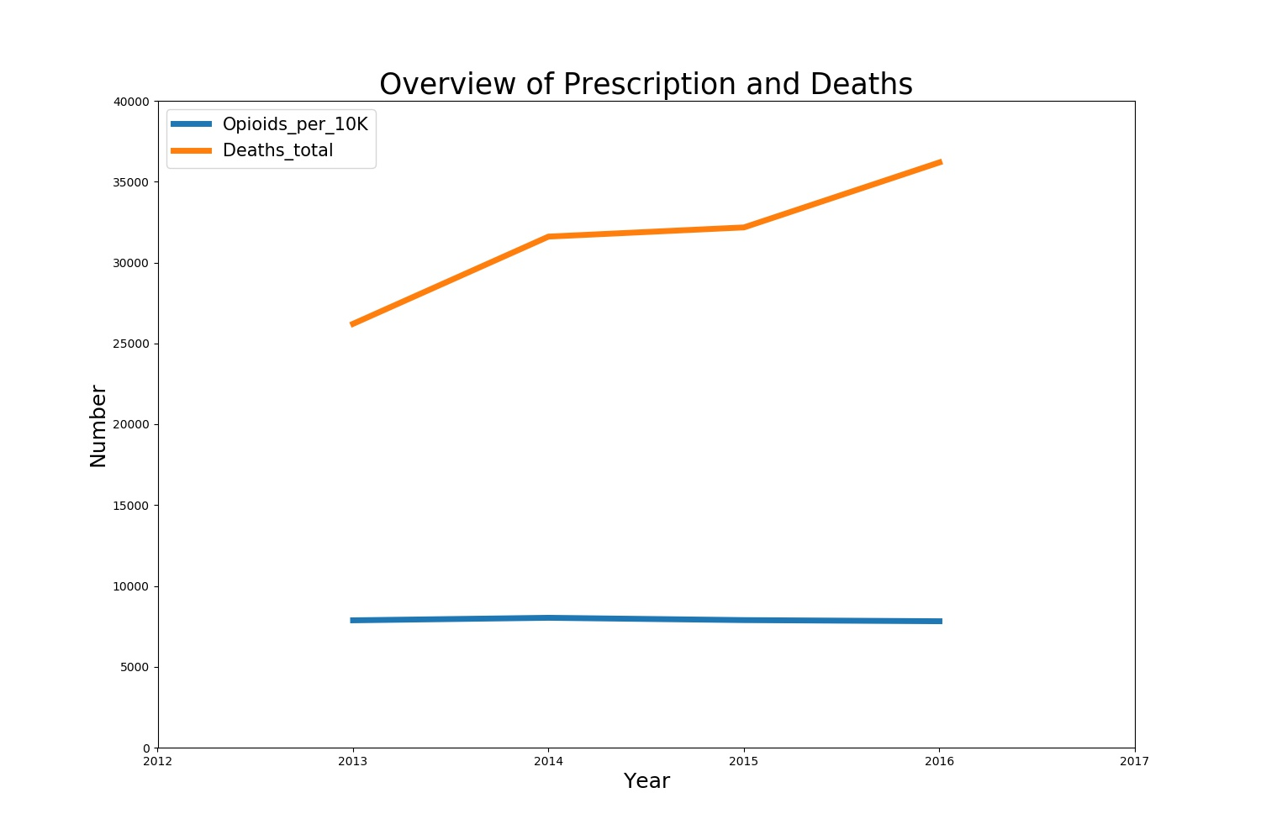
Prescription Changes vs. Mortality Changes

Slide 24
Prescription Changes vs. Mortality Changes
Overall, prescriptions rates either stayed unchanged or increased across the United States between 2013-2016 with a few exceptions.
Florida saw the largest increase in prescription rates.
Mortality mostly decreased in the Western half of the country and increased in the Eastern half.
West Virginia saw the biggest increase in deaths.

Slide 25
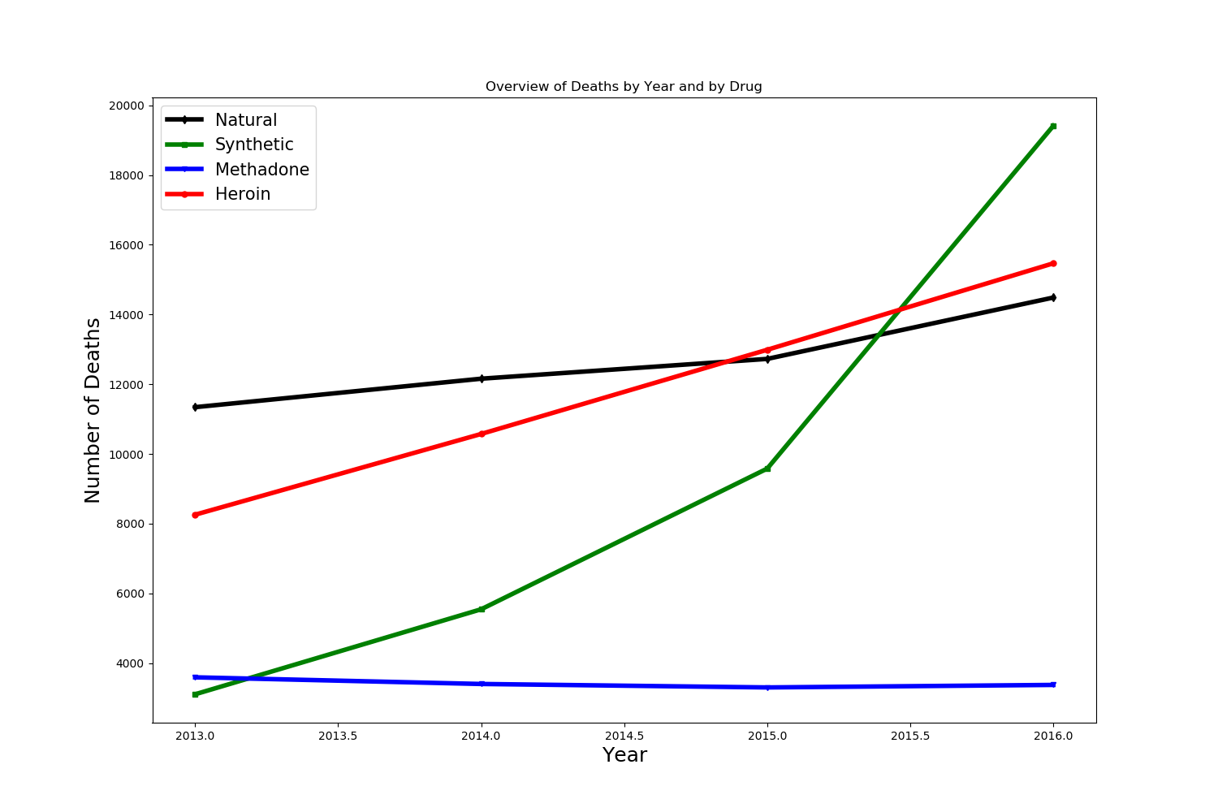
Total opioid deaths over four years in the US

Slide 26
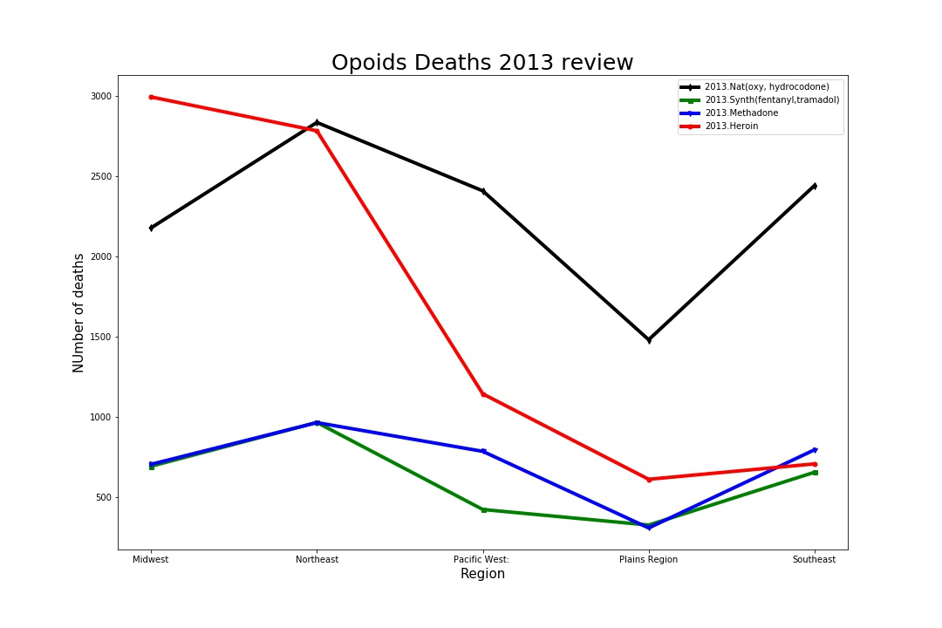
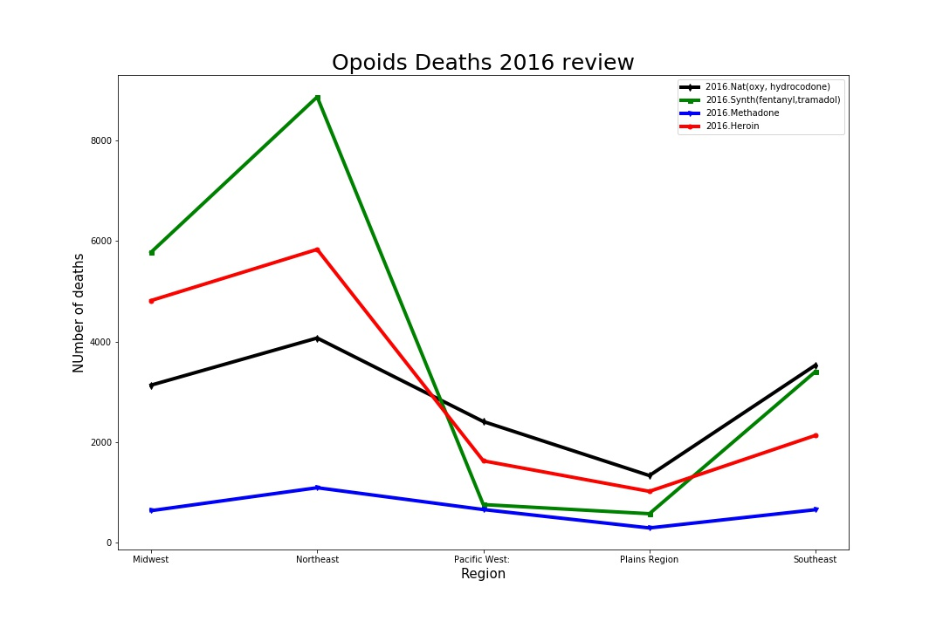
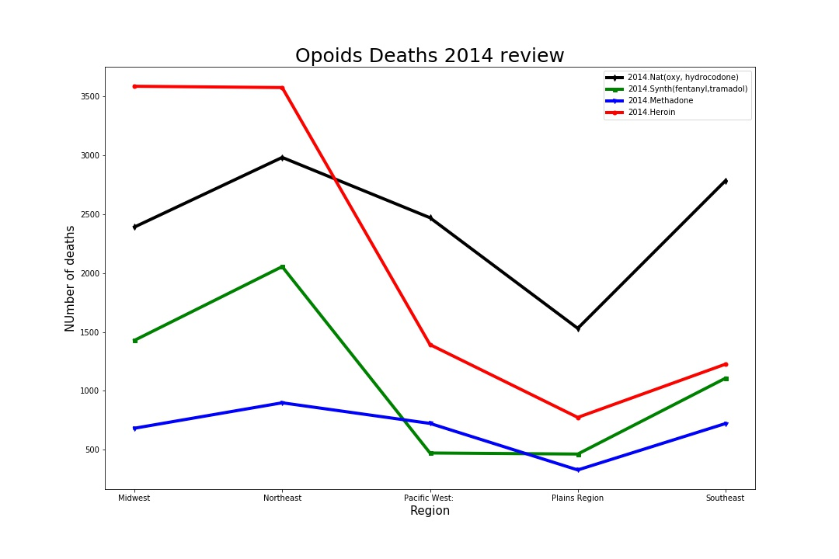
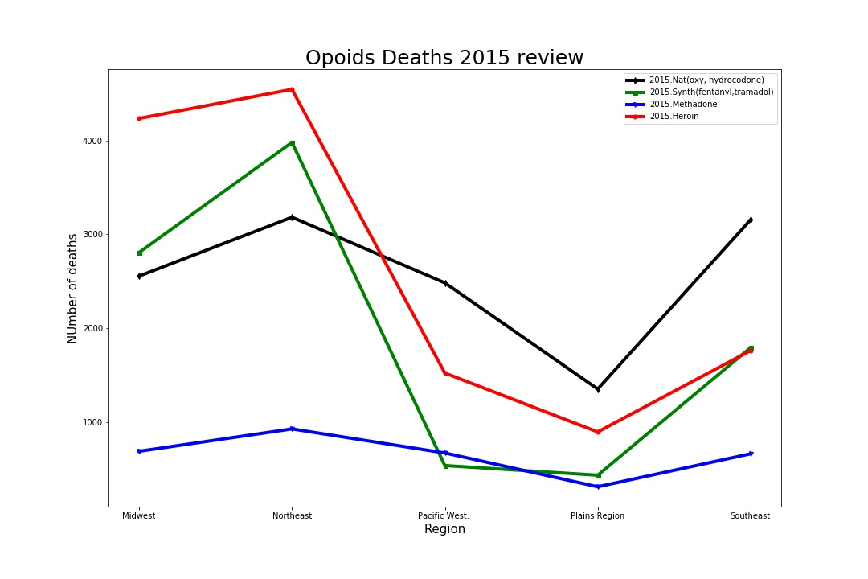
Opioid deaths by year
2013
2014
2015

Slide 27
Summary
Overdose death increase not in response to an increase in prescription rates
Increase in OD deaths in the US can be attributed to Synthetic opioids such as Fentanyl as we see a marked increase in deaths attributed to synthetic opioids from 2013-2016 especially in the Midwest and Northeast regions
Methadone seems to have the least number of casualties. May use it as part of treatment for an addiction to heroin or narcotic painkillers.
It blocks the high you get from drugs like codeine, heroin, hydrocodone, morphine, and oxycodone.
Future Directions:
Breakdown of prescription drug type by specialty
Investigate the rate of change in prescription of synthetic opioids(non methadone) vs methadone

Slide 28




Acknowledgements
The Half-Class Squad
Yazan Rizeq
Armi Cachila
Alex Talento
Tyler Cobb
John Rafferty
Rick Clauss
Hadijat Makinde
QUESTIONS?

Slide 29
EXTRA SLIDES IN CASE OF QUESTIONS

Slide 30
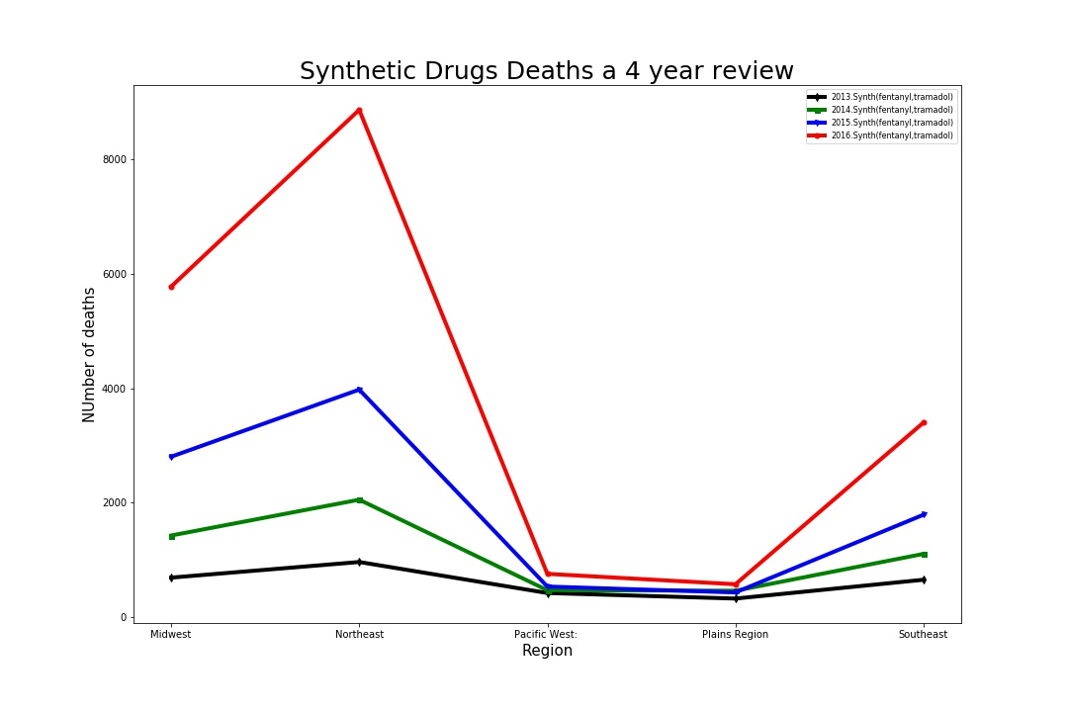
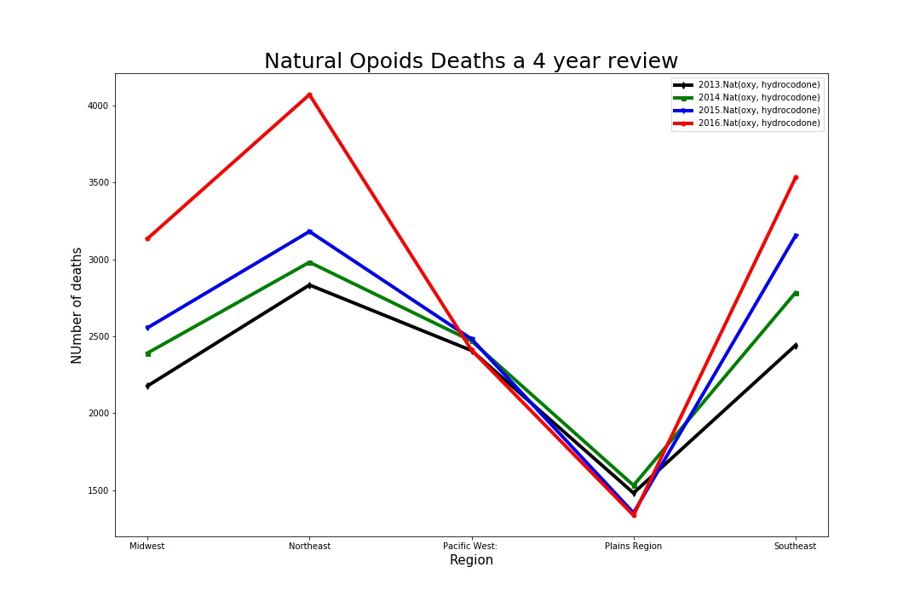
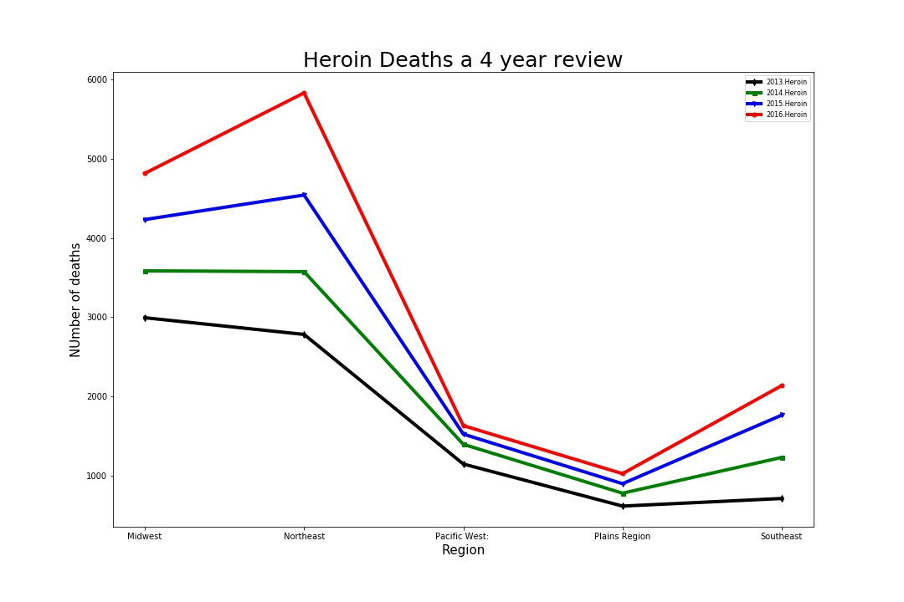
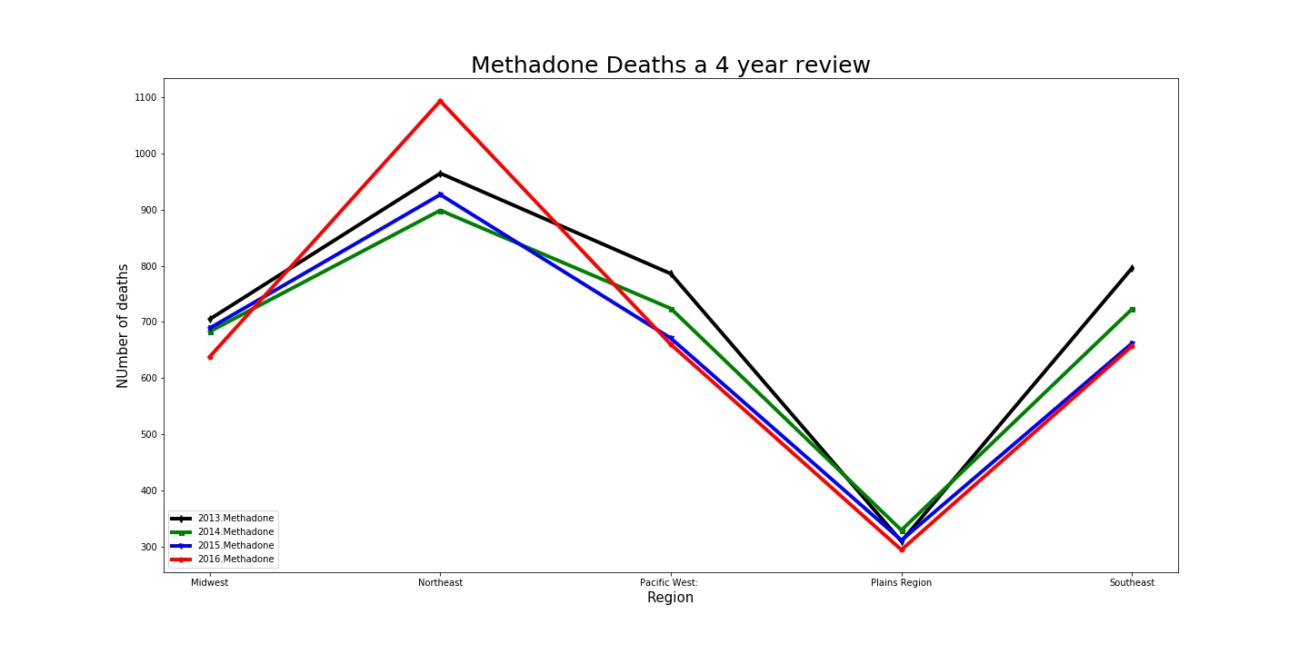
Opioid deaths by type of drug
4000
8000
6000
1100

Slide 31
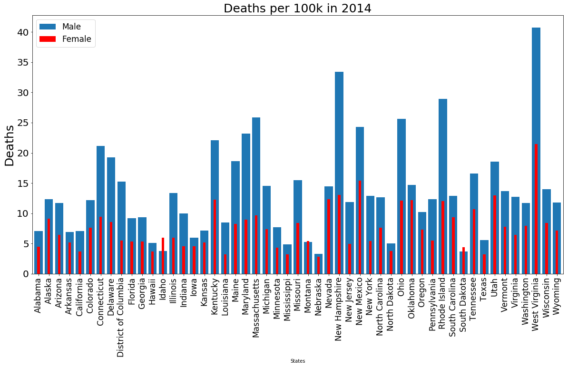
Opioid Deaths by Gender

Slide 32
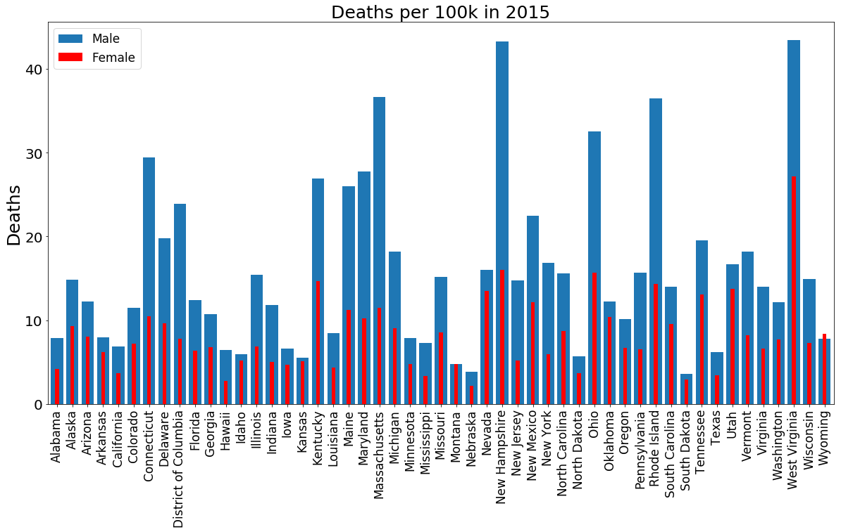
Opioid Deaths by Gender

Slide 33
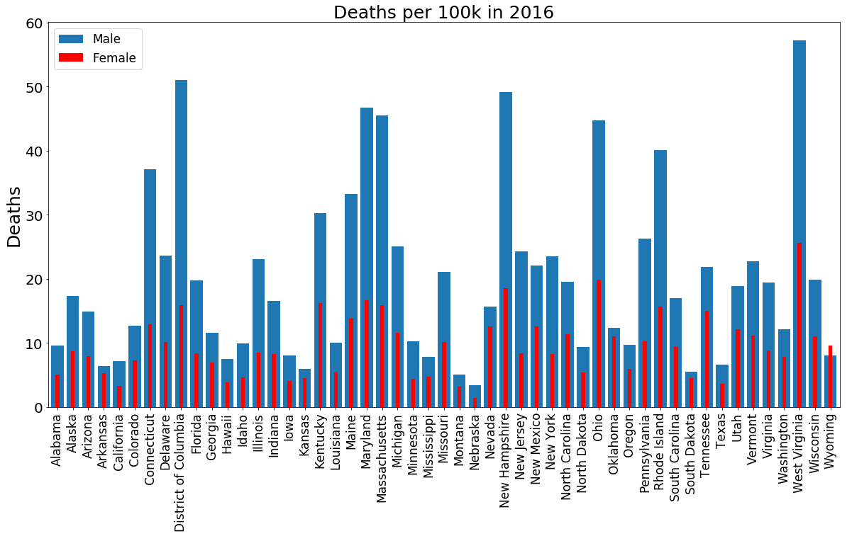
Opioid Deaths by Gender

Slide 34
A leader in health policy analysis and health journalism, the KFF is dedicated to filling the need for trusted information on national health issues. KFF is a non-profit organization focusing on national health issues, as well as the U.S. role in global health policy. Unlike grant-making foundations, Kaiser develops and runs its own policy analysis, journalism and communications programs, sometimes in partnership with major news organizations. KFF serves as a non-partisan source of facts, analysis and journalism for policymakers, the media, the health policy community and the public. Our product is information, always provided free of charge — from the most sophisticated policy research, to basic facts and numbers, to in depth health policy news coverage provided by our news service, KHN, to information young people can use to improve their health or the general public can use to understand the health reform law. The modern day KFF was established in the early 1990s with its current mission and operating style. It is not associated with Kaiser Permanente.

